Slide 1

STACK OVERFLOW - Query Mining
Prepared for CMSC 691 - BIG DATA (FALL 2015)
Presented by:
Nikita Jituri
Phanindra Kumar Kannaji
Sneha Tatipally Venkat

Slide 2
Introduction
Q&A sites work on a simple premise: that any user can pose a question, and in turn other users – potentially many of them – will provide an answer.
Tens of thousands of questions are asked and answered every day on question and answer (Q&A) Web sites such as StackOverflow.
Millions of programmers use StackOverflow to get high quality answers to their programming questions every day.
More than six thousand new questions is asked on StackOverflow every weekday

Slide 3
Problem Statement
Analysis of the data of Stack overflow which includes
Visualize the trends and statistics of the technologies specified in the question.
Providing the additional information of the tagged technologies.
Generating Top5 users and questions based on the tag given.

Slide 4
Motivation
To provide an interface for the user to get information about the technologies the user is working on
The motivation is to implement complex SQL queries in PIG scripts.

Slide 5
Data
Volume
Veracity

Slide 6
Dataset Description
Total dataset of 46GB which consists of:
11 million questions
17 million answers
42 million comments
38 thousand tags
3.4 million users

Slide 7
Dataset Components
Badges
Comments
Post History
Post Links
Posts
Tags
Users
Votes

Slide 8
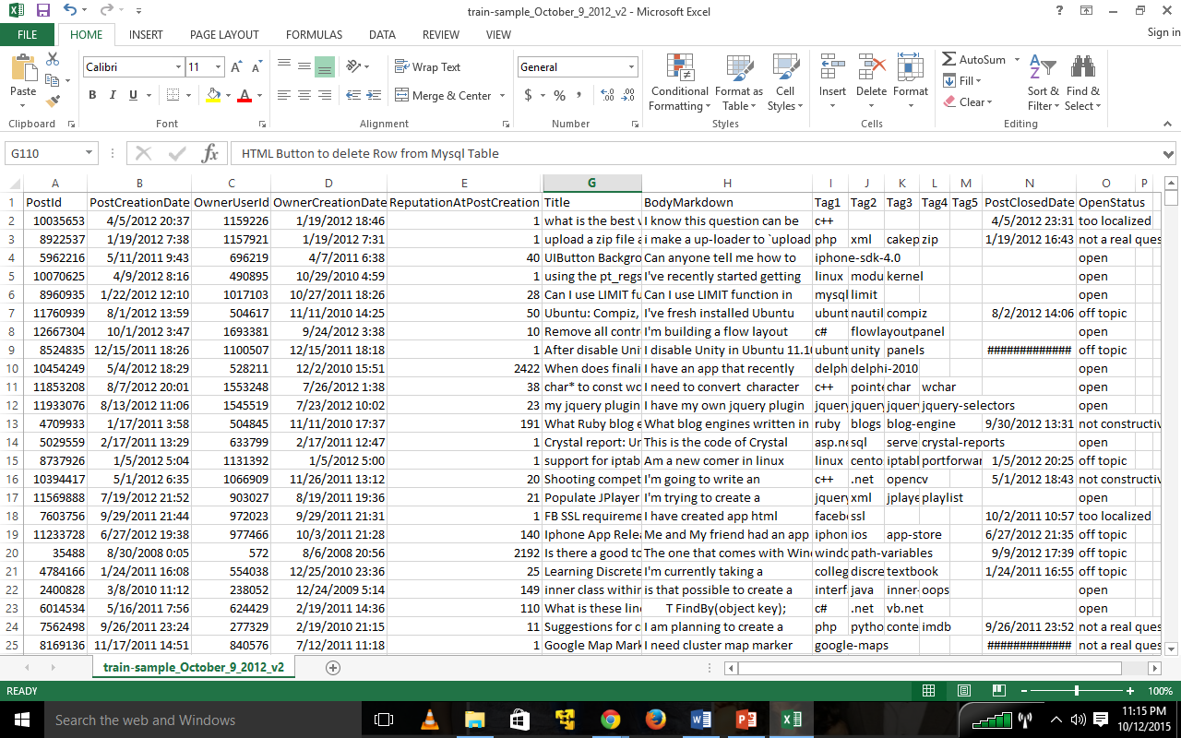
Sample Dataset

Slide 9
Input
User’s Question
Tags

Slide 10
Results
Tags identification
Additional information about the tags mentioned in the question such as
Total number of related questions
Total number of answers
Total number of accepted answers
Total number of closed questions
Total number of current open questions
Total numbers of users active on the related topic

Slide 11
Additional Services
Display the top five questions related to the tags provided by the user.
Display the top five users related to the tags provided by the user.

Slide 12

Implementation
Raw dataset
HDFS
Import
PIG
End User
Visualization :
HTML
Data filtering &
Information retrieval
Web application
SQLite

Slide 13
Analysis
Example: TotalNumberofActiveUsers(tag,year)
Description: Count total number of active users for a given tag per year:
Input values: Post(year, tag1, tag2, tag3, tag4, tag5, ownerUserId);
(Tag1,year) -> (year, tag1, ownerUserId)
(Tag1,year) -> (year, tag1, ownerUserId)
……
Counts the number of ownerUserId grouped by tag and year
Raw input of Post Details
MAP
REDUCE
Map the posts with tags and year
Counts the total number of users for each tag per year

Slide 14
Map Reduce Jobs(PIG Scripts)
We have implemented 4 PIG scripts.
Each PIG script runs 4-9 Map reduce jobs.

Slide 15
Map Reduce Jobs(PIG Scripts) (CONTINUED)
First PIG script calculates the following for a tag per year:
Total number of questions
Total number of answers
Total number of accepted answers
Total score
Total number of deleted questions
Total number of closed questions

Slide 16
Map Reduce Jobs(PIG Scripts) (CONTINUED)
The results are as follows:
(mapreduce,2008,9,4,0,279,61,1)
(mechanize,2014,314,115,0,128,262,7)
(merb-auth,2008,2,2,0,1,2,0)
(mergeinfo,2012,5,4,0,20,7,0)
(mergetool,2009,4,2,0,44,9,0)
(messenger,2013,28,13,0,26,27,1)
(metatable,2014,15,6,0,28,20,0)

Slide 17
Map Reduce Jobs(PIG Scripts) (CONTINUED)
Second PIG script calculates total number of active users for a tag per year. The results are as follows:
(internet-explorer-9,2010,150)
(intrusion-detection,2010,3)
(io-completion-ports,2012,11)
(ios-standalone-mode,2012,5)
(iphone-softkeyboard,2008,5)
(iphone-softkeyboard,2013,10)

Slide 18
Map Reduce Jobs(PIG Scripts) (CONTINUED)
Third PIG script calculates Top 5 questions for a tag. The results are as follows:
(apache-pig,3356259,90017,Difference between Pig and Hive? Why have both?,hadoop,hive,apache-pig,piglatin,)
(apache-pig,13911501,28664,When to use Hadoop, HBase, Hive and Pig?,hadoop,hbase,hive,apache-pig,)
(apache-pig,9900761,25476,PIG how to count a number of rows in alias,hadoop,apache-pig,,,)
(apache-pig,3515481,20119,Pig Latin: Load multiple files from a date range (part of the directory structure),hadoop,apache-pig,piglatin,,)
(apache-pig,5013003,13885,How do I parse JSON in Pig?,json,apache-pig,piglatin,,)
(hadoop2,22316187,2125,Datanode not starts correctly,hadoop,hadoop2,,,)

Slide 19
SQL Query to find Top5 users when a Tag is given:
select Q.tag, A.user_id, U.display_name, U.profile_image_url, count(*) as ans_count from (select post_id as answer_id, parent_id as question_id, owner_user_id as user_id from Posts) A, ( (select post_id as question_id, tag1 as tag from Posts where tag1 is not null) UNION (select post_id as question_id, tag2 as tag from Posts where tag2 is not null) UNION (select post_id as question_id, tag3 as tag from Posts where tag3 is not null) UNION (select post_id as question_id, tag4 as tag from Posts where tag4 is not null) UNION (select post_id as question_id, tag5 as tag from Posts where tag5 is not null) ) Q, (select user_id, display_name, profile_image_url from Users) U WHERE A.question_id=Q.question_id AND Q.tag IS NOT NULL AND A.user_id = U.user_id ) GROUP BY Q.tag, A.user_id, U.display_name, U.profile_image_url ORDER BY COUNT(*) DESC LIMIT 5

Slide 20
Map Reduce Jobs(PIG Scripts) (CONTINUED)
Fourth Pig script calculates Top 5 users for a tag. The results are as follows:
(allegro,1968,78,Konrad Rudolph,)
(allegro,4381,39,Vicent Marti,)
(amazon-javascript-sdk,174184,3,TJ-,)
(angular-seed,39396,14,Carl G,)
(angular-seed,345944,9,Liad Livnat,)
(angular-seed,38611,8,zilupe,)
(angular-seed,1691,1,olore,)

Slide 21
More About Map Reduce Jobs
Time taken for each script are as follows:
First script: 1 hour 30 minutes
Second script: 2 hour 45 minutes
Third script: 1 hour
Fourth script: 45 minutes

Slide 22
Data Visualization
For example if we type a question as “ What is the best database for Django” then the data visualization will be displayed as mentioned further.

Slide 23
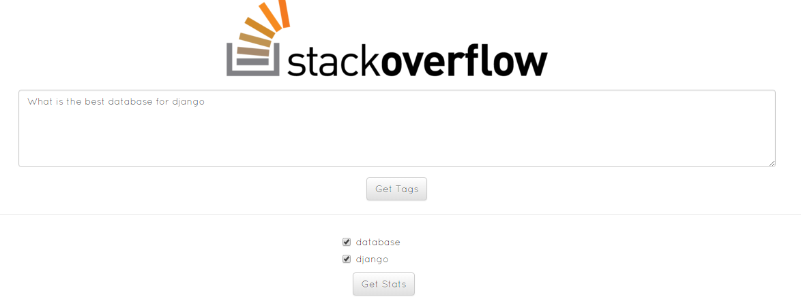
Data Visualization

Slide 24
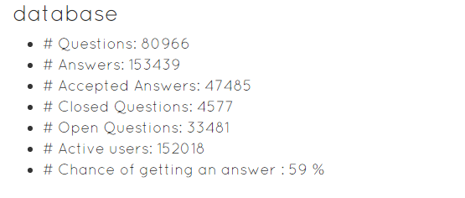
Data Visualization

Slide 25
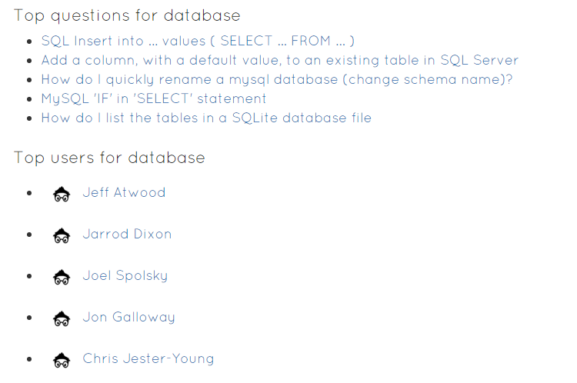
Data Visualization

Slide 26
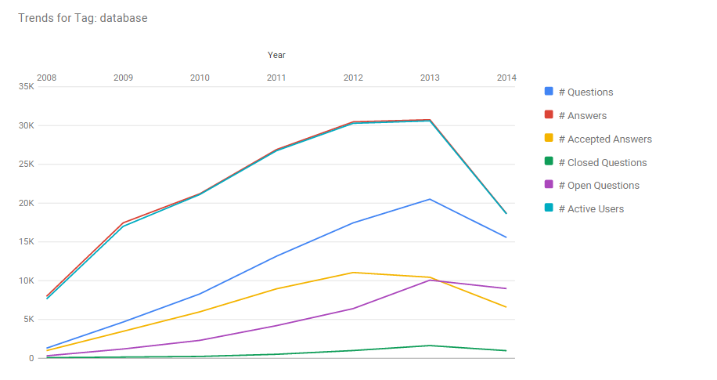
Data Visualization

Slide 27
DEMO

Slide 28
Tools
Apache Hadoop
Apache PIG
SQLite
Django Framework
Google Charts
PyCharm
Ajax, JSON
Bootstrap

Slide 29
Road Blocks
Handling variable data schema.
We tried to install the web application in HPCF but there is no webhosting provided.

Slide 30
Roles and Responsibilities
SERVICE | PERSON ASSIGNED
Dataset analysis | Nikita
HDFS | Phanindra, Nikita, Sneha
Web GUI | Sneha
Hadoop | Phanindra, Sneha, Nikita
Data Storage | Nikita, Sneha
Apache PIG | Phanindra, Sneha
Testing | Nikita, Sneha, Phanindra
Paper | Sneha, Nikita, Phanindra

Slide 31
Schedule
Finalizing the topic
Finalizing the technologies
Finalizing the architecture
Analyzing the dataset
Demo Web page
Initial Presentation
Loading data to HDFS
Loading data to PIG
Build the Machine Learning Model
Test the model on test dataset
MIDTERM PRESENTATION
Add the web GUI to the processed data
Test the project
FINAL PRESENTATION
IEEE Paper

Slide 32
Related Work
Clayton Stanley, Michael D. Byrne. 2013. Predicting Tags for StackOverﬂow Posts In 12th International Conference on Cognitive Modelling. , pages 414-419.
Fabio Calefato, Filippo Lanubile, Maria Concetta Marasciulo, Nicole Novielli. Mining Successful Answers in Stack Overflow. In Proceedings of MSR 2015, The 12th Working Conference on Mining Software Repositories.

Slide 33
References
https://www.kaggle.com/c/predict-closed-questions-on-stack-overflow/data
http://blog.stackoverflow.com/2009/06/stack-overflow-creative-commons-data-dump/
http://stackoverflow.com/help/closed-questions
http://stackoverflow.com/questions/10059594/a-simple-explanation-of-naive-bayes-classification
http://meta.stackexchange.com/questions/2677/database-schema-documentation-for-the-public-data-dump-and-sede

Slide 34
References(Continued)
https://pig.apache.org/docs/r0.7.0/piglatin_ref2.html#Arithmetic+Operators+and+More
https://pig.apache.org/docs/r0.9.1/func.html#size
https://www.qubole.com/resources/cheatsheet/pig-function-cheat-sheet/

Slide 35

THANK YOU Questions (If any)

